Slide 1
Creating a Great PowerPoint Presentation
Presented by Frank Byl PowerConcepts
Notes:
Getting set up
If you have downloaded the file be sure to save the file to your desktop or somewhere convenient
What is the keyboard shortcut to undo? Ctrl Z will be your friend.
Take a look at the “TABS”. We will see context sensitive tabs always on the left.
Ask for help on-line in chat or just put up your hand or throw something at me if you are here

Slide 2
Organize thoughts
Use View/Outline View
Don’t type on the screen
Use tab and shift tab
Use Alt Shift and Arrow keys
Max five lines per page
Notes:
Many people make a PowerPoint by clicking on the slide and entering text and then adding a new slide and repeating the process
Work in Outline view
Go to end of this slide push enter and get a new bullet. Push tab and it demotes. Push Shift Tab to promote. Keep doing Shift tab and it will eventually become a new slide. Enter text and press enter to get a new slide.
Enter always give you more of the same
Tab and Shift tab demote and promote
Alt and Shift and Arrow keys select current bullet and moves it in direction of arrow
Group all files that end with an “*” under the preceding heading
The do Ctrl H to find and replace with nothing

Slide 3
Three Learning Styles
Notes:
A ggod idea to organize your presentation is to “Tell them what you are going to tell them. Tell them. Tell them what you have told them.”
Auditory – Talking
Visual – Presentation
Kinesthetic – Use movement to highlight and bring focus

Slide 4
Auditory*

Slide 5
Visual*

Slide 6
Kinesthetic*

Slide 7
Types of Content

Slide 8
Text*

Slide 9
Pictures*

Slide 10
Video*

Slide 11
Smart Art*

Slide 12
Table*

Slide 13
Charts*

Slide 14
Text
Bullets
Sub bullets
Max of 6
Notes:
Add some new bullets
First idea
Second idea
Go back and add sub points

Slide 15
Pictures
Pictures from Insert tab
Try Stock, web or on computer
Resize from corner
Try holding Ctrl
Move with four-sided arrow
Try holding Shift
Right click for options
Picture Format toolbar options
Try Compress pictures
Try various picture frames
Notes:
Click on Picture to see “Picture Format”
Change frame
Crop
Layer
Compress – compress is very important to do at the end of completing a presentation to reduce file size
Resize from corner
Try holding Ctrl
Flip picture horizontally or vertically with Ctrl and drag corner sideways or vertically past center of picture
Move with four-sided arrow
Try holding Shift
Add Pictures from Insert tab
Try STOCK, web or on computer
Copy this slide when complete and remove pictures from first one and text from second one

Slide 16
Video
Copy this url https://youtu.be/QRg5PGNmLA0?si=TQ3wG8AnOSsG4SjH
Go to Insert tab
Go Insert a video
Online video
Paste the URL
Resize the video
Notes:
When done copy the slide and Delete video from first and text from second one

Slide 17
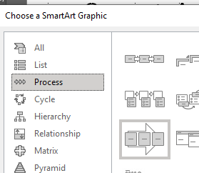
Smart Art
First copy all these bullets
Insert Smart Art
Select Process
Continuous Block
Paste Into text box
Use Alt Shift and Arrow to move
Format the Smart Art
Colors
Shapes
Change Smart Art Entirely
Use Smart Art Ribbon (Tab)
Notes:
When done copy the slide and delete smart art from first and text from second
Be sure to start one from scratch using a blank slide

Slide 18
New Smart Art

Slide 19
Table
Name | Dept | Ext | Email
Notes:
Insert Table on Insert Tab. Various options to size

Slide 20
Excel Table
Notes:
Total the table
Add a total to the left and resize the table with black handles and then exit and then resize with white handles

Slide 21
Charts
Select chart
To see Chart Tab
Notice options
Edit data
Enter Fraser data
Change format
Change chart
Change it back

Slide 22
Design
Switch to normal view
Select Design
Change colors
Change fonts
Then Select Design/Designer
Only one slide at a time
Notes:
MUST be in normal view to use the designer
Only do one slide at a time

Slide 23
Movement

Slide 24
Animation*

Slide 25
Transitions*

Slide 26
Transition
In Slide Sorter View
Go to Transitions and choose
Note duration options

Slide 27
Animation
Must be in slide view
Select Animation
Note duration
Turn on Animation Pane
Expand and collapse
Note options on each bullet
Notes:
Get sub bullets to move independently by expanding Animation tab

Slide 28
Animating Charts
Select chart
Select Animation (“Wipe” works well)
Go to Animation Pane
Select chart and options
Effect options
Chart Options
Don’t animate chart background
Notes:
Try Element in Series

Slide 29
Notes
Notes:
Go to View and Handout Master
Go to View and Notes Master

Slide 30
Speaker*
Add below the slide in Normal View

Slide 31
Audience Paper Notes*
View/Handout Master

Slide 32
Speaker Paper Notes*
View/Notes Master

Slide 33
Printing Notes
File print
3 slides per page is perfect for audience
“Notes” page or “Outline” for speaker

Slide 34
Getting ready for the Presentation
Record Timing
Slide show/Record timings
Notice total time and time per slide

Slide 35
Editing Timing
Slide sorter view
first and last
Others
“Just In Case” slides
Notes:
Slide sorter view
None on first and last
None on others where you might pause
Using “Just In Case” hidden slides
Press H to show hidden slides

Slide 36
Frank’s Favourites keyboard shortcuts
S for stop and start
W or B for white or black
Ctrl P for pen
Ctrl A for arrow
Ctrl H to hide
F5 to start
Any number and enter takes you to that slide
H shows a hidden slide
Notes:
S for stop and start
W or B for white or black
Ctrl P for pen
Ctrl A for arrow
Ctrl H to hide
F5 to start
Any number and enter takes you to that slide
H shows a hidden slide

Slide 37
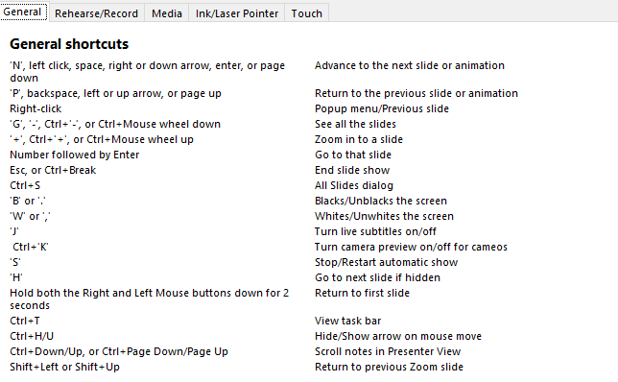
Keyboard shortcuts
F1 for help

Slide 38
Use the options at the bottom left of the screen

Slide 39
Presentation Tips
Less is best
One step at a time
Talk to the audience
Notes:
Less is best. Viewer word. Just hooks. They should be listening to you
One step at a time. Keep the audience at the same place as you
Talk to the audience. NOT to the screen
Use the screen highlight tools
Use timings to free you up and keep you on pace

Slide 40
Thank you for joining
Reach out any time to PowerConcepts.ca
Frank@PowerConcepts.ca

